Slide 1

The eNanoMapper Ontology
Jiakang Chang jkchang@ebi.ac.uk

Slide 2
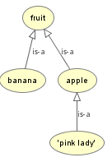
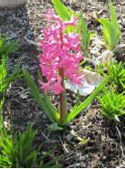
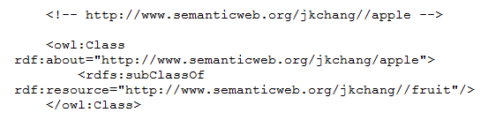
What is an ontology?
Philosophy
Ontology
Artificial
Intelligence
Knowledge
Representation
and logic
(forall((x FloweringPlant)) (exists((y Bloom)(z BloomColor))( and (hasPart x y)(hasCharacterisitic y z)
Translation: every flowering plant has a bloom which is a part of it , and which has a characteristic bloom color.
Notes:
Plato

Slide 3
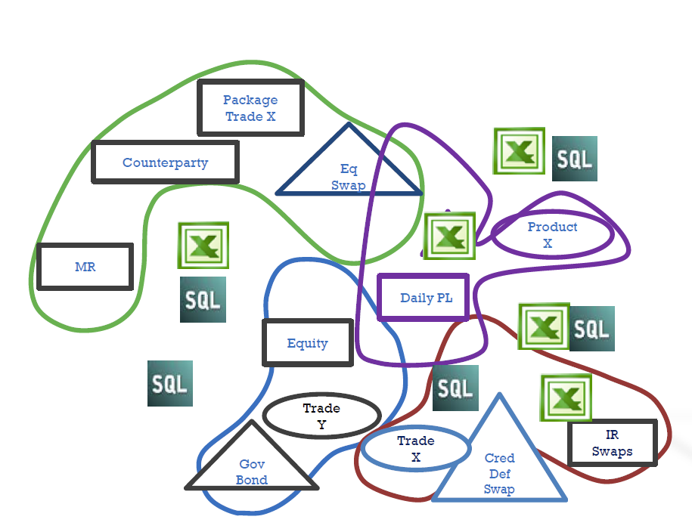
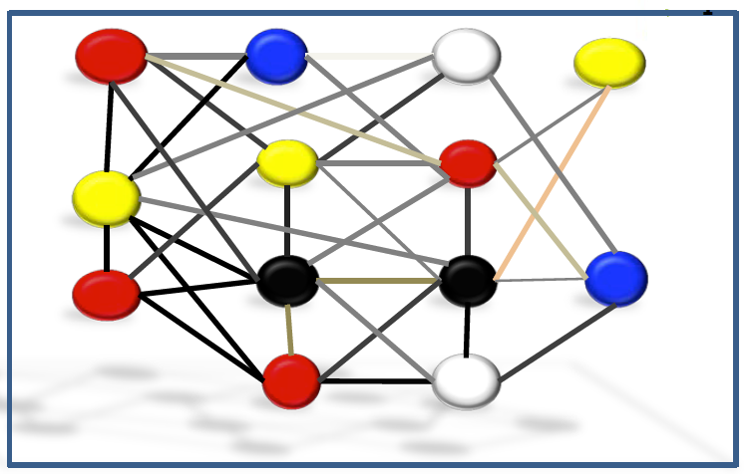
The eNanoMapper -A Database and Ontology Framework for Nanomaterials Design and Safety Assessment
Data incongruity and fragmentation often found across silos
Limited data standards
Brittle schemas are costly to change
Costly application program logic required to process data into concepts
Rigid and limited taxonomies
Data linkage and integration despite silos
Open global reusable data standards
Flexible changeable schemas
Highly expressive data schemas with built in rules that reflect concepts
Rich multi-level taxonomies

Slide 4
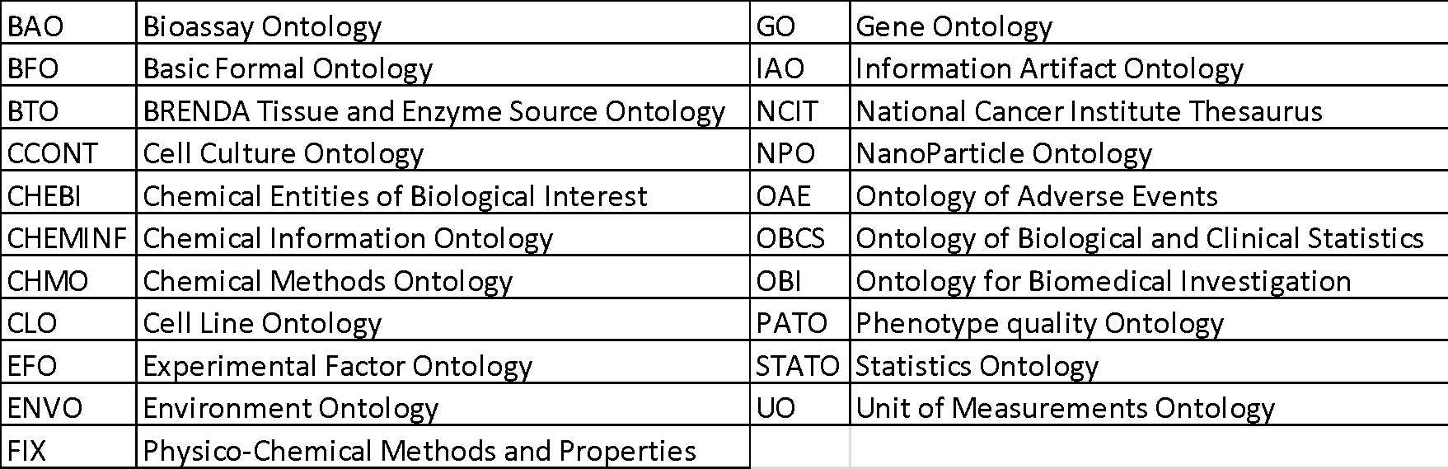
eNanoMapper ontologies
Comprehensive ontology for the nano-safety domain, encompassing nanomaterial and all information relating to their characterization, as well as information describing relevant experimental paradigms, biological interactions, safety indications.
Table 1: Version 3 contains 21 external ontology sources

Slide 5
The slimming procedure of the eNM ontology
Split up source ontologies into “minimal units” for each different part of the domain covered
Sort out duplication by removing entities from one of the ontologies’ relevant modules
Import these minimal units back into a fully assembled ontology
Automated so that it can be done over and over with source ontology releases
The eNM Ontology
Ontology a
Ontology b

Slide 6
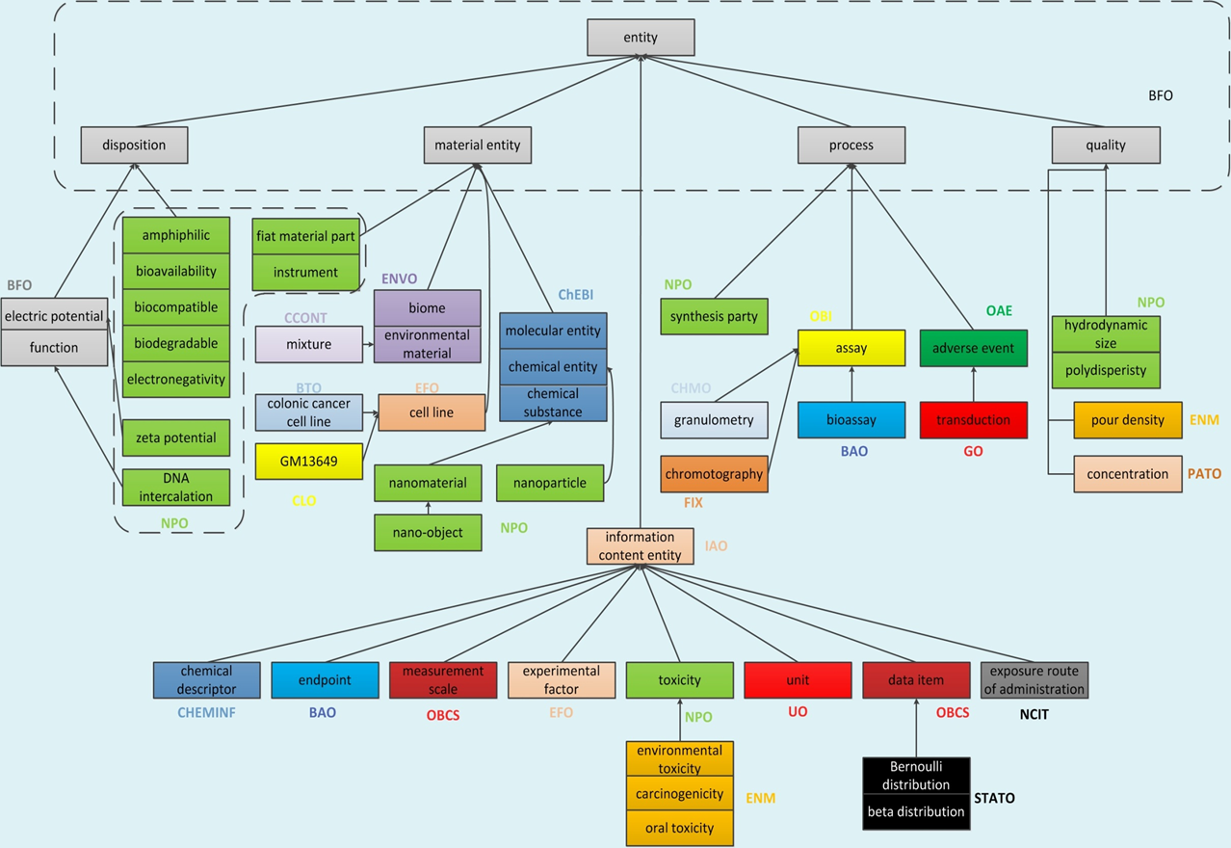
Version 3.0
Totally 8407 classes, 73990 Axioms

Slide 7
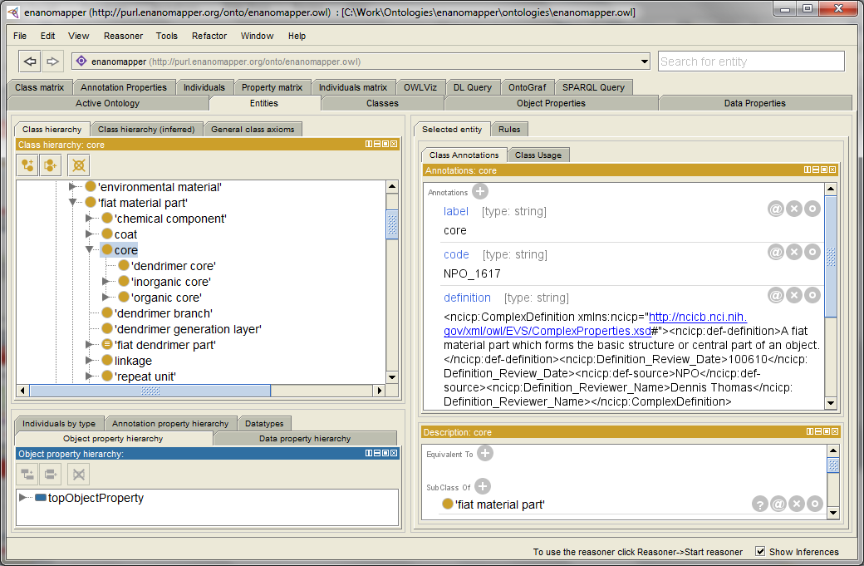
Browsing the eNanoMapper Ontology
Online
Three main ontology repositories:
BioPortal http://bioportal.bioontology.org/ontologies/ENM
Aber-OWL http://aber-owl.net/ontology/ENM
Ontology Lookup Service (OLS) http://www.ebi.ac.uk/ols/beta/ontologies/enm
Locally
Protégé http://protege.stanford.edu/
Open from local .owl file
Open from URL

Slide 8
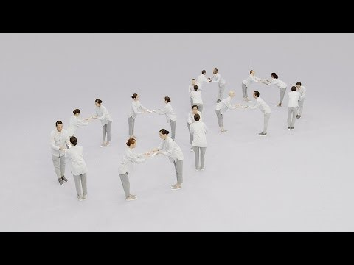
Data Sharing & Reuse

Slide 9
Thank You

